Slide 1
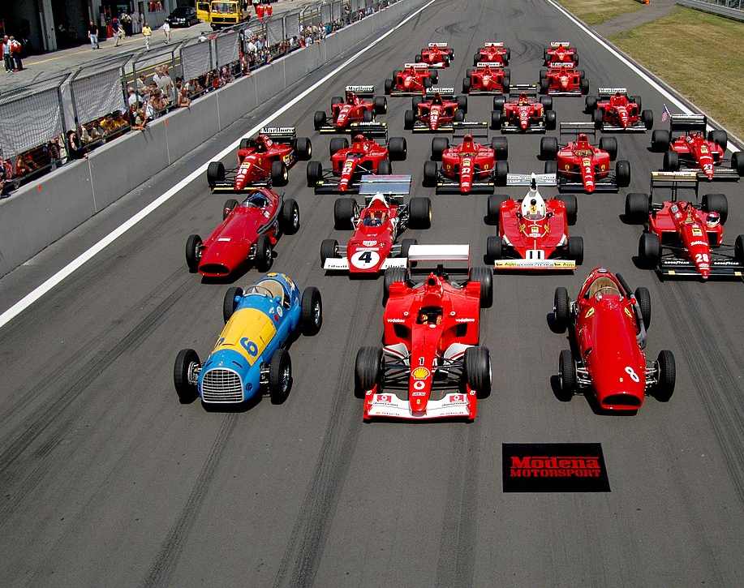
Decision Modeling for Formula 1 datasets
A Linear Regression Approach to Predicting Win Rates for Formula 1 Drivers
Team Members: Amy Ikp, Samantha Nader, Justin Harper

Slide 2
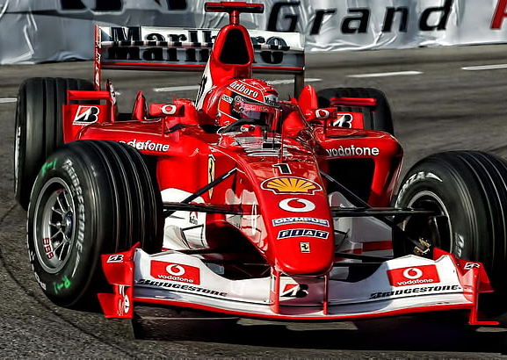
Objectives
Understand factors influencing driver win rates in Formula 1.
Use linear regression to model the relationship between performance metrics and win rates.
Tools Used: Python, Google CoLab, Visual Studio, GitHub

Slide 3
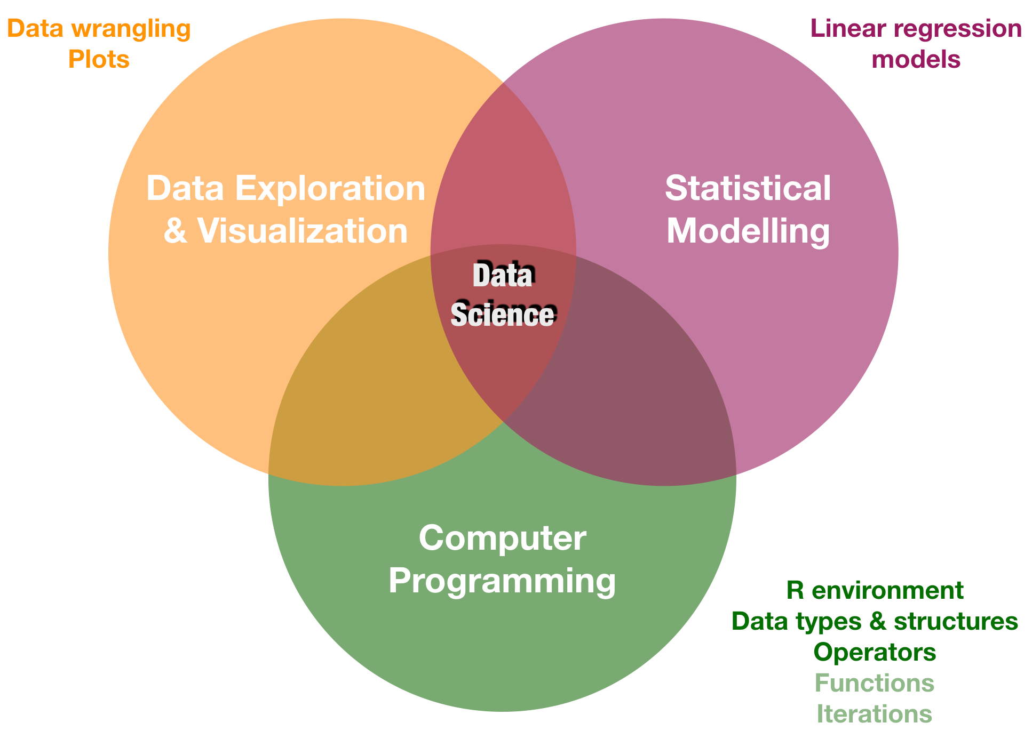
Data Overview/Preparation
Data Preparation
EDA on selected datasets
Merged datasets to create a comprehensive performance dataset.
Calculated total races, total wins, and win rates for each driver.
Calculated Top 10 drivers by points and season
Calculated Top 10 constructor by points and season
Correlation matrices for Results and Constructor dataset
Features for regression model
Datasets Used:
Results
Drivers
Constructors_results
Pit_stops
Constructor_standings
Key Features:
Total Races
Total Wins
Age
Constructor Performance Points

Slide 4
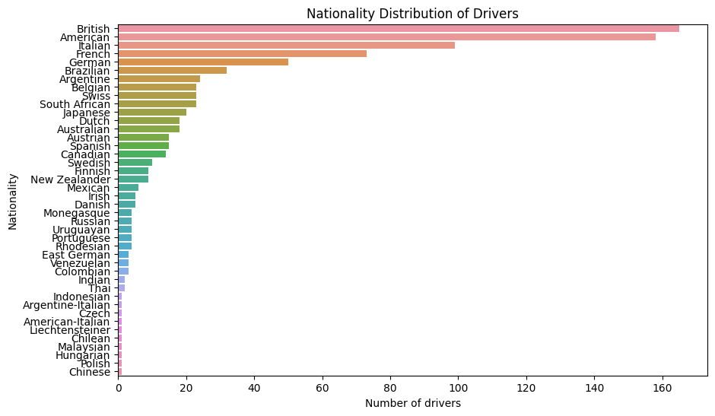
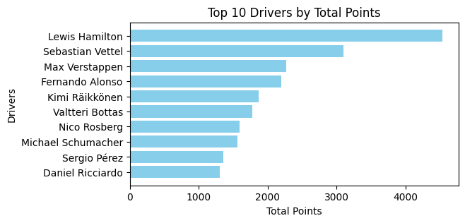
EDA(1)
Notes:
Highest numbers of drivers are British followed closely by Americans.
Top 10 drivers by total points. Hamilton leads the pack with most points, this is obvious since he has the most wins with 103 wins.

Slide 5
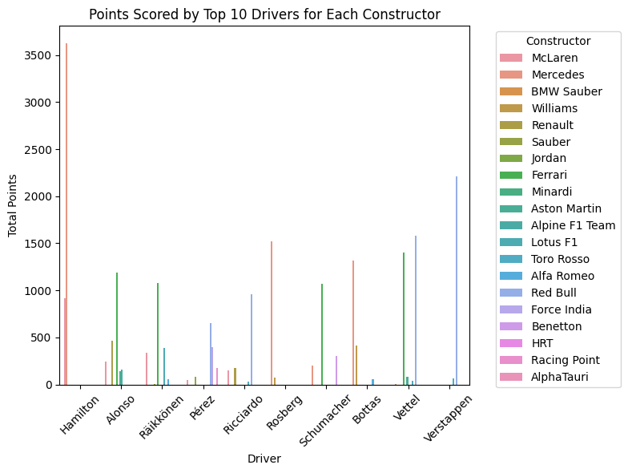
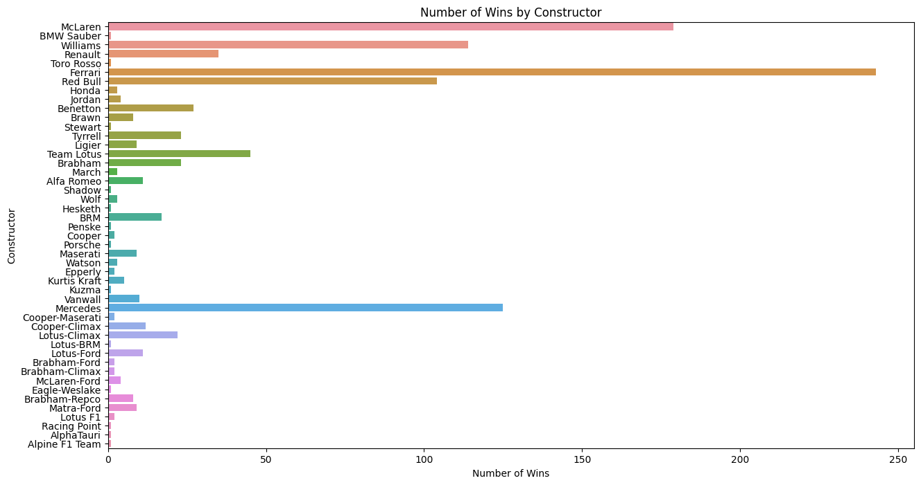
EDA(2)
Hamilton has scored the most points for Mclaren
Followed closely by Verstappen
Ferrari leads the constructors with more wins, thanks to the number of racers that use Ferrari.
Notes:
Hamilton has used Mclaren and Mercedes for most of his races
Ferrari has the most constructor wins because more drivers have used them
Red bull has in latest seasons been used by Vertsappen, racking up points for them

Slide 6
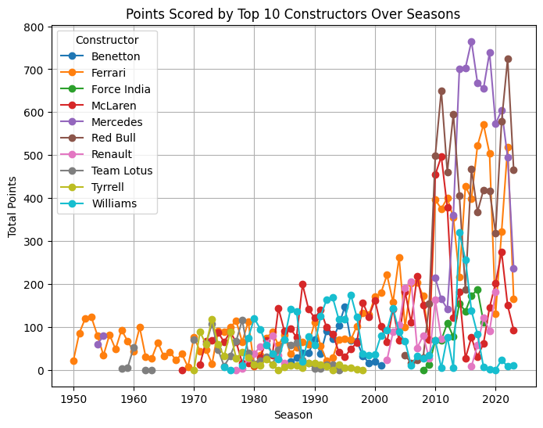
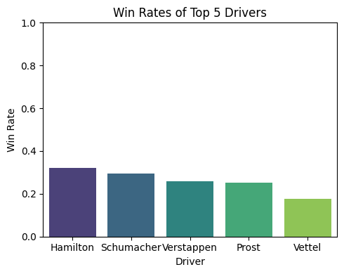
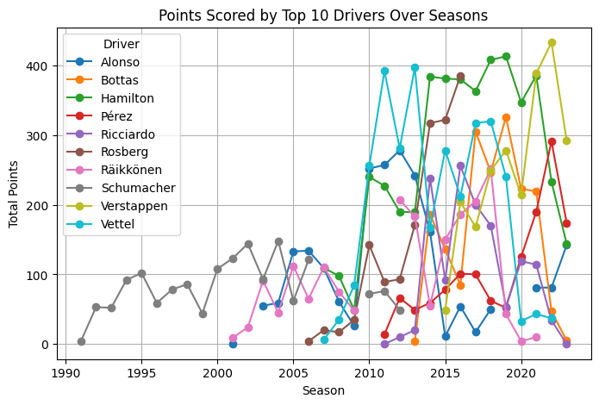
EDA(3)
win rates of top 5 drivers
points scored by top 10 constructors
Points scored by Top 10 drivers
Notes:
Mercedes and Red Bull are Top Constructors in recent seasons thanks to Hamilton and Vertsappen
Hamilton has the highest win rates
Vertsappen is leading in current season, followed closely by Hamilton. Schumacher was top until the 2000s when his competitos emerged in the form of Alonso, Raikkonen and Vettel.

Slide 7
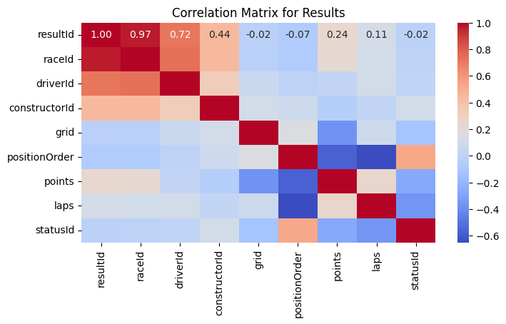
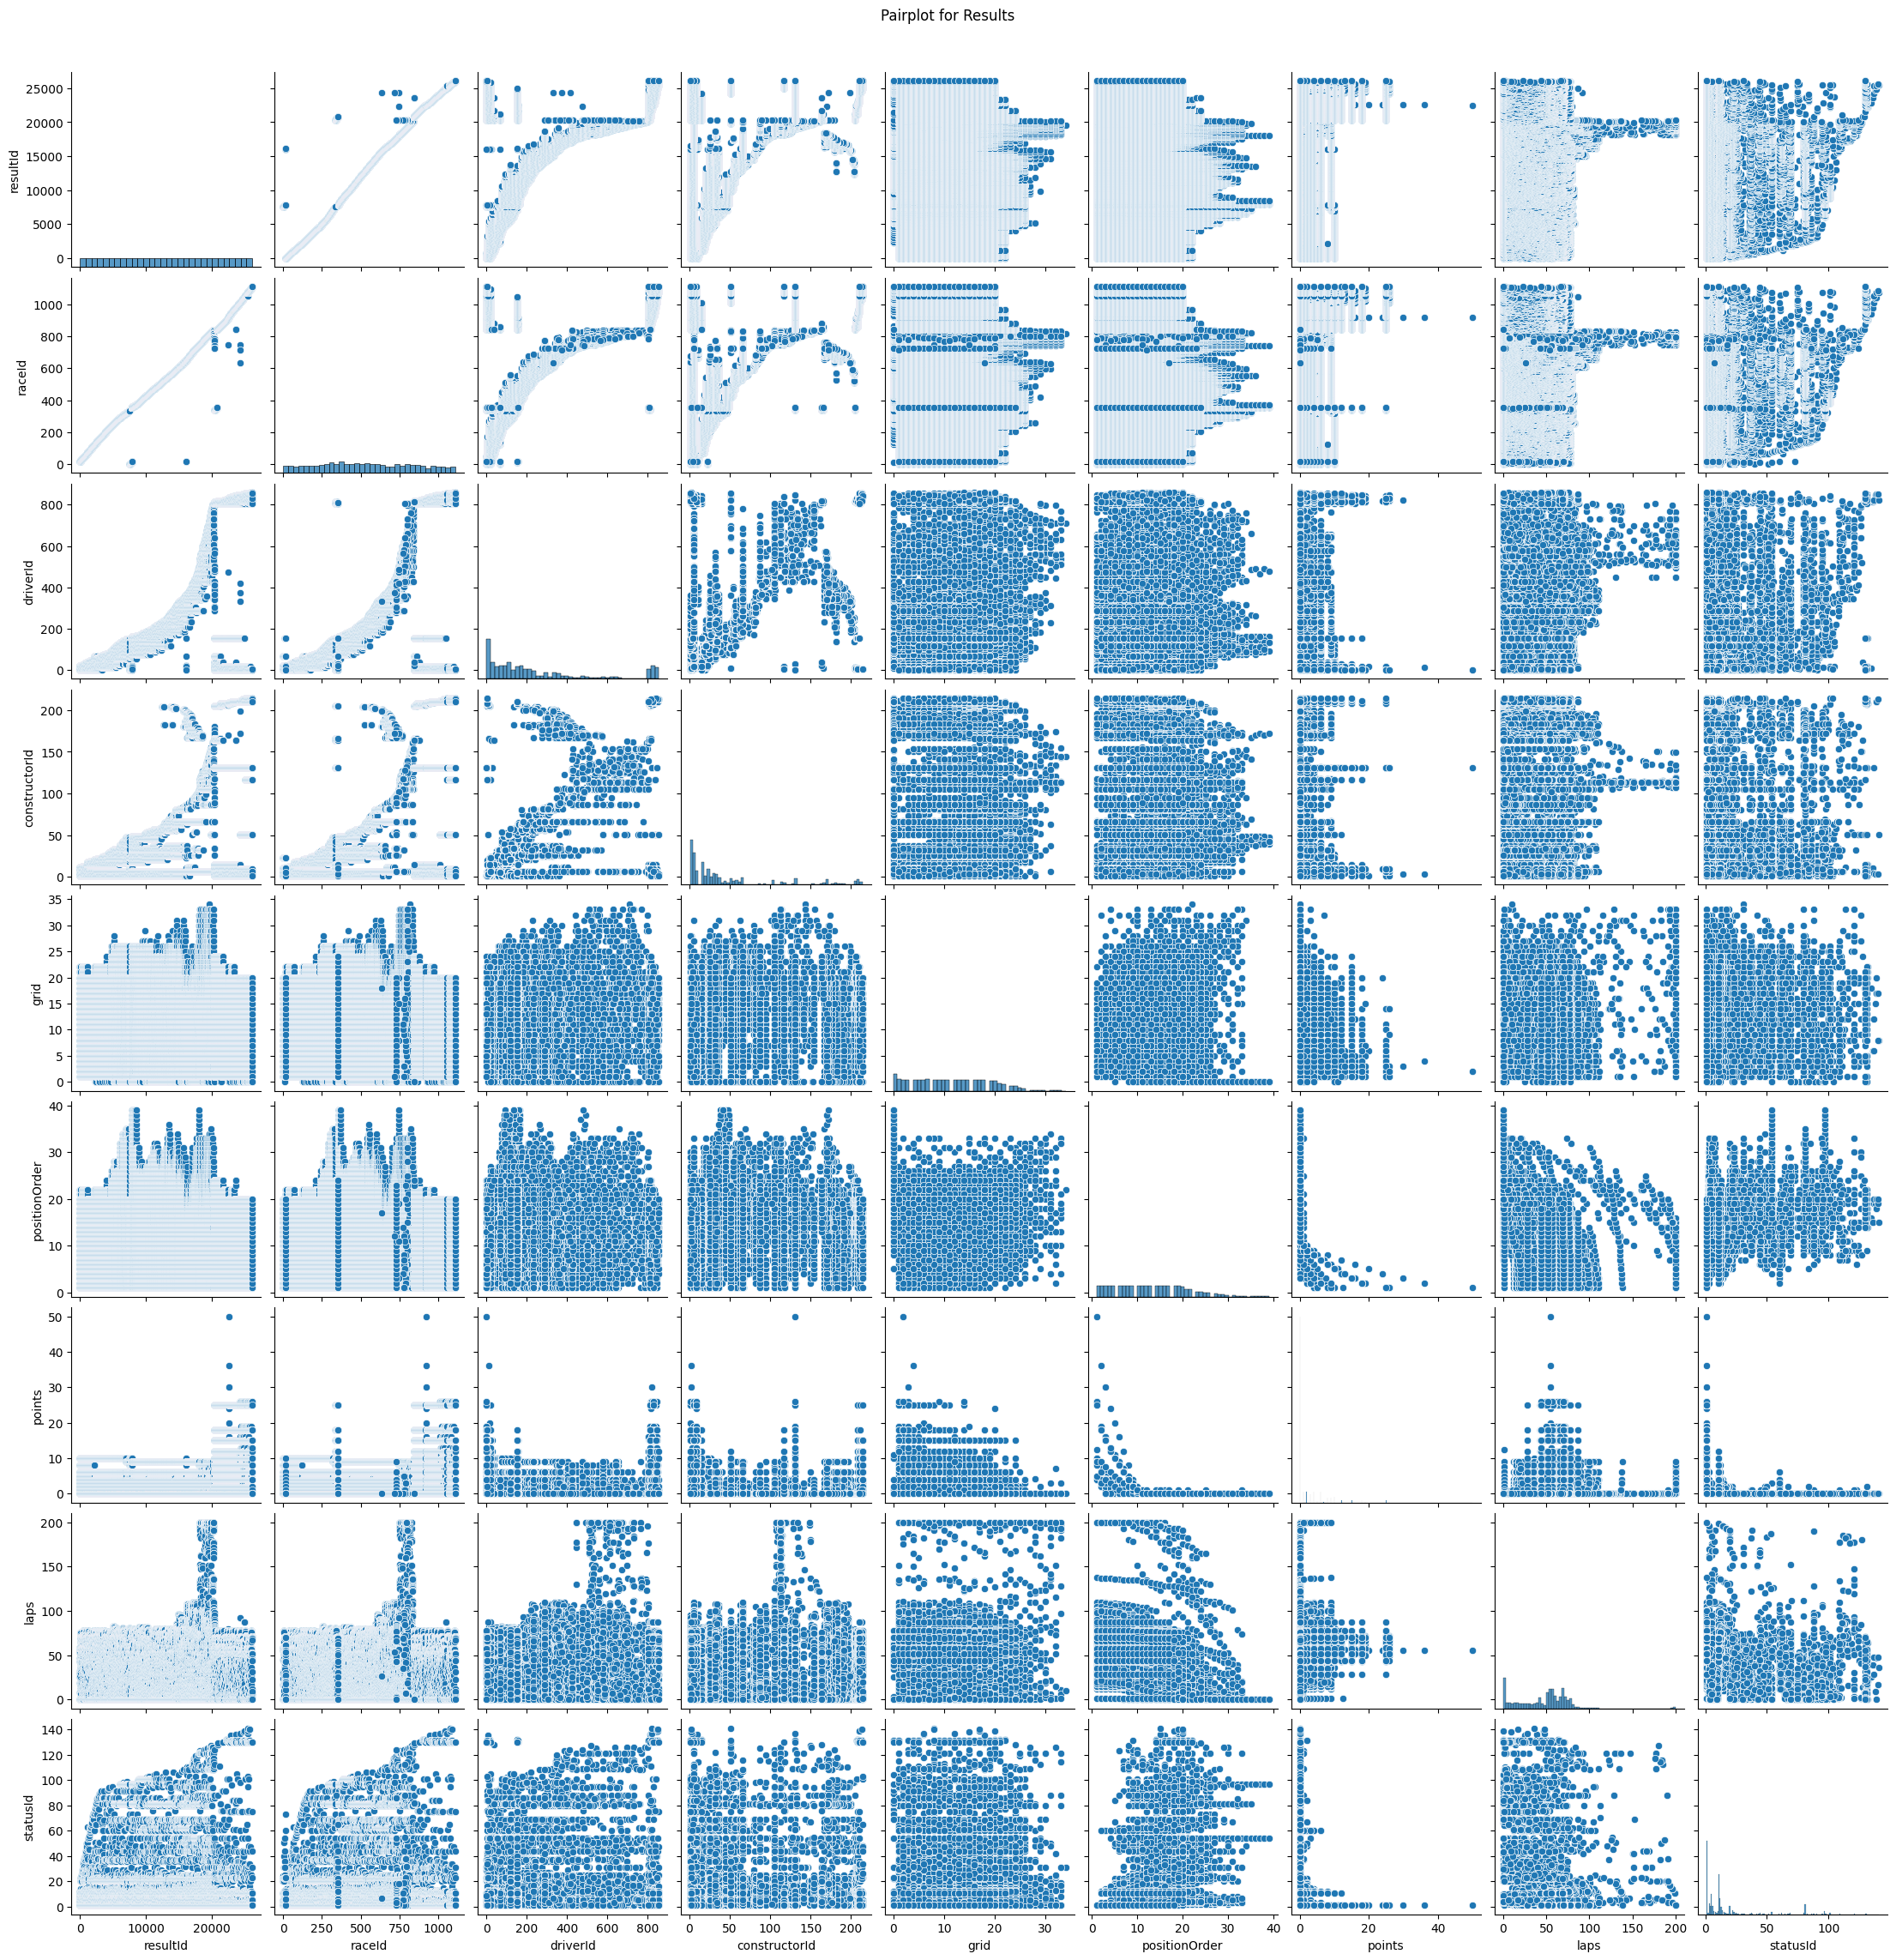
Correlation Matrix/PairPlots
Pairplots with diagonal and off-diagonal plots showing relationship bewteen variables
Correlation Matrix for results:
High correlation between results and race
Moderate correlation between driverId and constructorId(0.44)
Low correlation between grid and other variables(0)
Notes:
Correlation is from negative 1 (-1) to positive 1 (+1).
1: Perfect positive correlation (as one variable increases, the other also increases).
-1: Perfect negative correlation (as one variable increases, the other decreases).
0: No correlation (no linear relationship between variables).

Slide 8
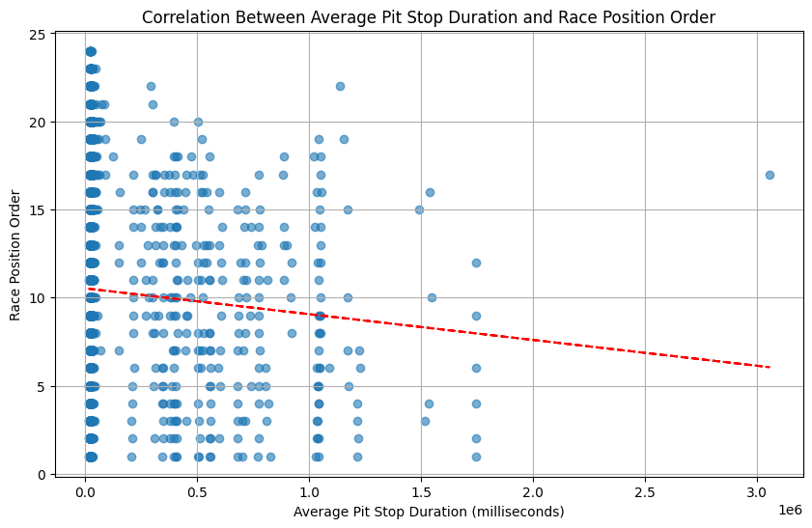
Correlation between Pit Stop and Race Position Order
Key Observations:
Negative Correlation: There is a slight negative correlation, as suggested by the downward slope of the red trend line.
Shorter average pit stop durations are generally associated with better race positions (lower position order).
Data Distribution:
Many data points are clustered around shorter pit stop durations (close to 0), indicating that most pit stops are relatively quick.
There is a wide spread of race position orders for short pit stops, showing variability in race outcomes despite quick stops.
Notes:
Teams with consistently shorter pit stops may achieve better race positions.
While pit stop duration is a factor, it is not the sole determinant of race position, as indicated by the variability in race positions for similar pit stop durations.

Slide 9
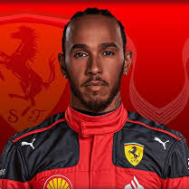

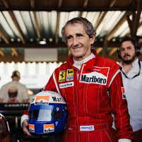


Top 5 Drivers by Win Rate
Hamilton
Verstappen
Top 5 Drivers by Win Rate
Identified the top 5 drivers based on win rate.
Displayed driver details (name, total wins, total races, win rate, age).
Prost
Schumacher
Vettel
Notes:
Hamilton has the highest win-rate, followed by schumacher

Slide 10

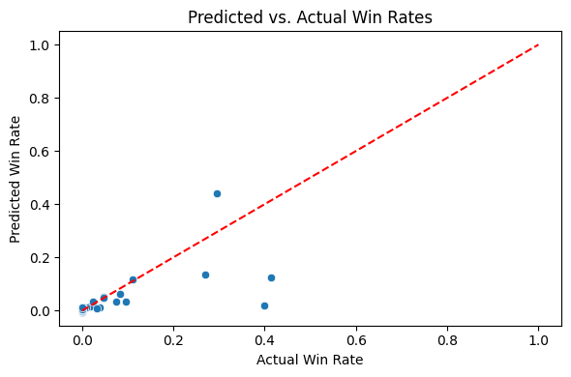
Linear Regression Model
Features Used:
Total Races
Total Wins
Age
Constructor Performance Points
Target Variable: Win Rate
Scatter plot showing predicted vs. actual win rates.
Regression line indicating trend.
Notes:
A linear regression models the relationship between the dependent variable (the variable you want to predict) and one or more independent variables (the variables used to make the prediction) by fitting a linear equation to the observed data.

Slide 11

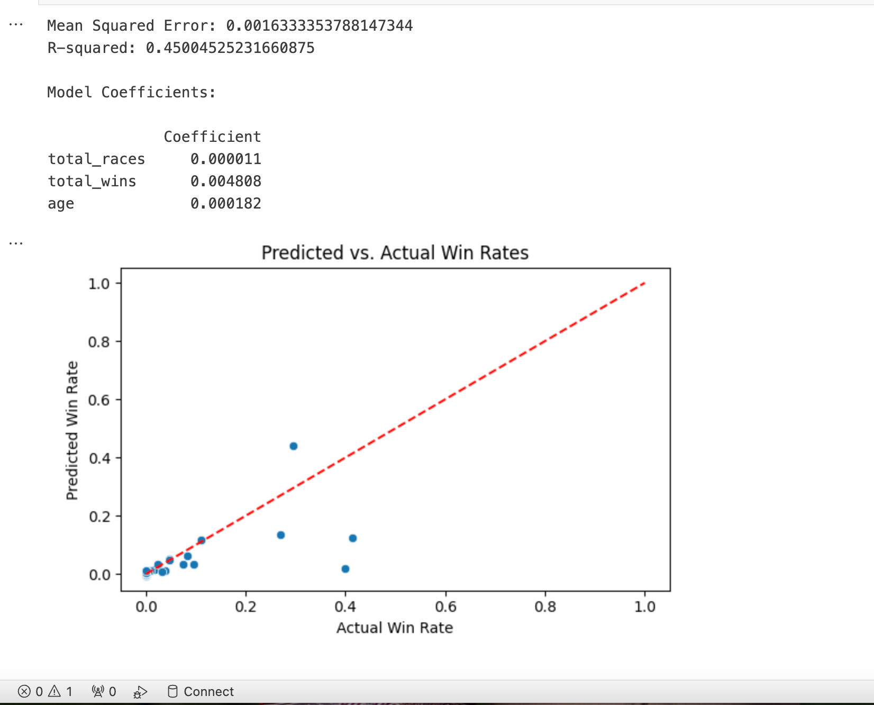
Model Coefficients/Performance
Total Races: Coefficient = 0.000011
Total Wins: Coefficient = 0.004808
Age: Coefficient = 0.000182
Constructor Points: Coefficient = 0.000013
Mean Squared Error(MSE): 0.0016(A lower MSE indicates a better fit of the model to the data)
R-Squared (R²): 0.45 (a measure of how well the model explains the variability of the data. R² of 0.45 = 45% of the variance in the performance metric can be explained by the model. The closer this value is to 1, the better the model explains the data)
n/b: This is a moderate level of explanatory power, which suggests that while the model captures some important relationships, there is still considerable variance unexplained.
Notes:
A lower MSE indicates a better fit of the model to the data used. here, 0.0016 simply says that the model's predictions are kind of close to the actual values.
In essence, each additional race, win, year of age, and constructor point contributes a bit of increase to the performance metric, with race wins having the largest individual effect.

Slide 12

Conclusion
The linear regression model provides insights into factors influencing win rates.
Total wins and constructor points have a significant impact on win rates.
The model can be further improved with additional features and advanced modelling techniques.
Notes:
Regression model partially predicts the win rates.
Wins and constructor points has significance on win rates.
Model can be improved by fine tuning to reduce noise.
Other forms of regression models e.g Random forest can be done.

